Slide 1
Tutorial on ANI neural network potentials and Auto3D
Zhen (Jack) Liu
Advisor: Professor Olexandr Isayev
Nov. 17th, 2022
Notes:
Welcome + topic

Slide 2
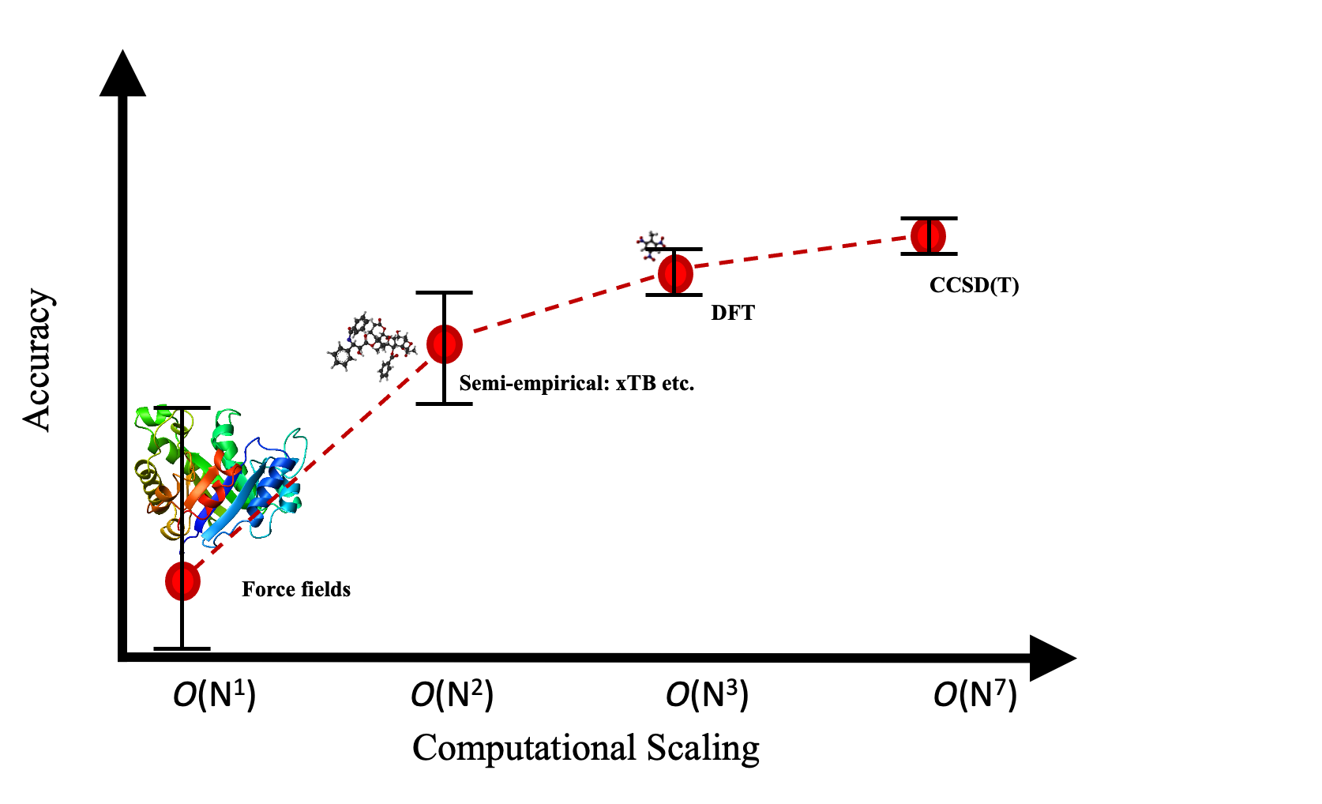
Trade-off between accuracy and cost

Slide 3
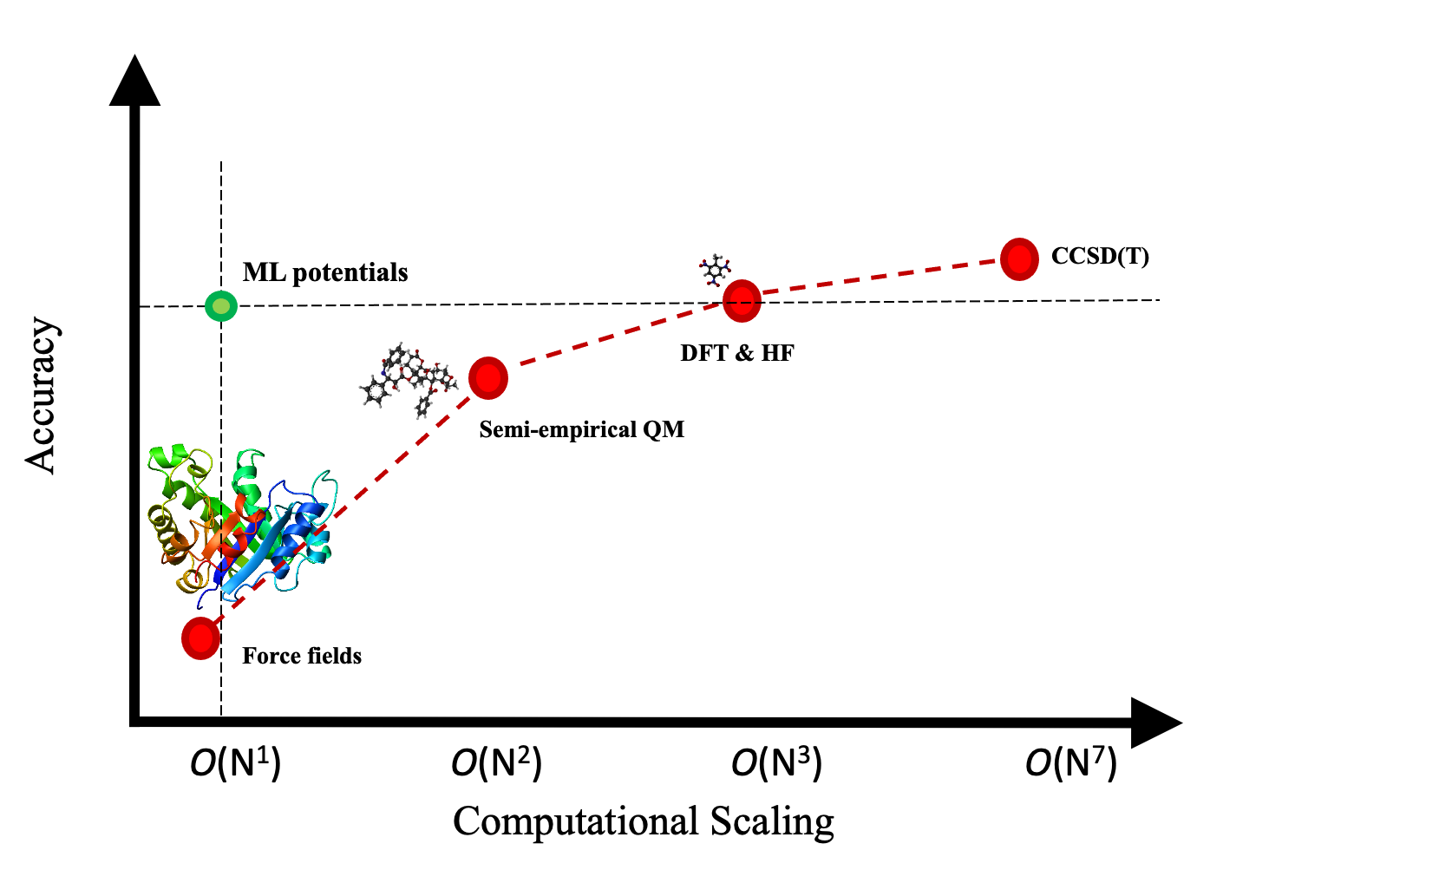
Trade-off between accuracy and cost

Slide 4
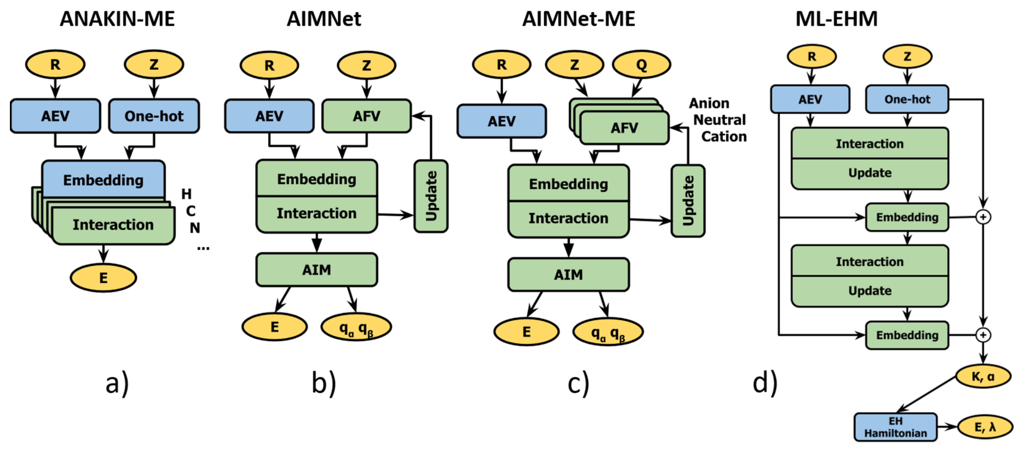
Neural network potential (NNP)
Express the total molecular energy as a sum of environment-dependent atomic contributions
Atomic environmental representation is invariant to rotation, translation and permutation
Optional long-range and/or non-local interaction embedding
Trained to a huge electronic structure data set
Zubatiuk, T., Isayev, O., Acc. Chem. Res. 2021, 54(7), 1575
Notes:
Replace graph

Slide 5
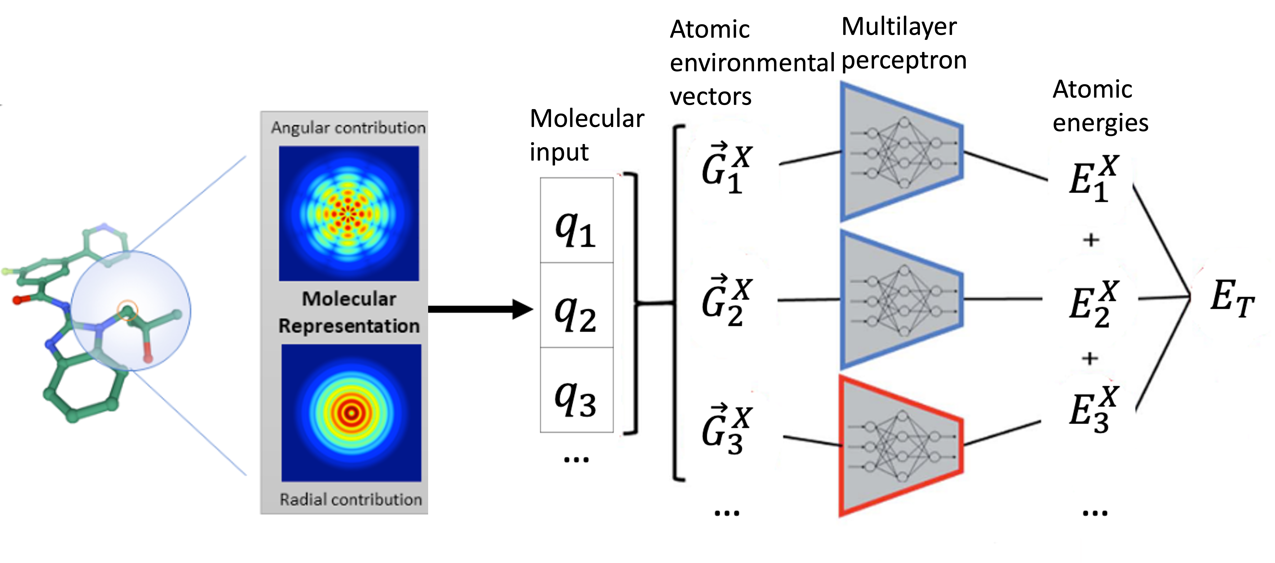
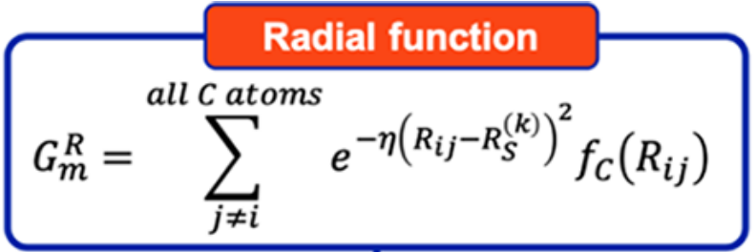
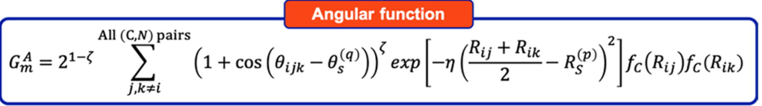
ANI: a neural network potential family
Include ANI-1, ANI-1x, ANI-1ccx, ANI-2x
Input: element and 3D coordinates
Output: energies and forces
﻿Smith, J. et al. Chem. Sci. 2017, 8, 3192; Gao, X. et al. J. Chem. Inf. Model. 2020, 60, 3408

Slide 6
Auto3D: finds the low-energy 3D conformer from SMILES
Input: SMILES
Output: 3D structures
Isomer engine: RDKit/OMEGA
Optimizing engine: ANI-2x/AIMNET/ANI-2xt
https://doi.org/10.1021/acs.jcim.2c00817

Slide 7
Outline for the tutorial Jupyter notebook
Part I: Setting up RDKit and Auto3D
Part II: RDKit essential function tutorial
Part III: Auto3D usage show case
Part IV: In class practice

